Slide 1

Matrices and Linear Algebra
Shiquan Zhang
shiquanzhang@scu.edu.cn

Slide 2
Introduction
Comments
Why we need to learn this course?
What we need to learn?

Slide 3
Resume
2000—2010: students of Sichuan University
2008—2009: visiting student at PSU
2009—2010: visiting student at PKU
2011—2013: postdoc in Europe
2014-- : full professor at math, SCU

Slide 4
Language:English or Chinese?
Official (lecture time): English, according to the rules of SCUPI, most time Chinese
Office hour: Chinese
Private: Chinese
Purpose: learn math not English
Office hour: 12:00—13:30, Wednesday,
Art building 3-319A

Slide 5
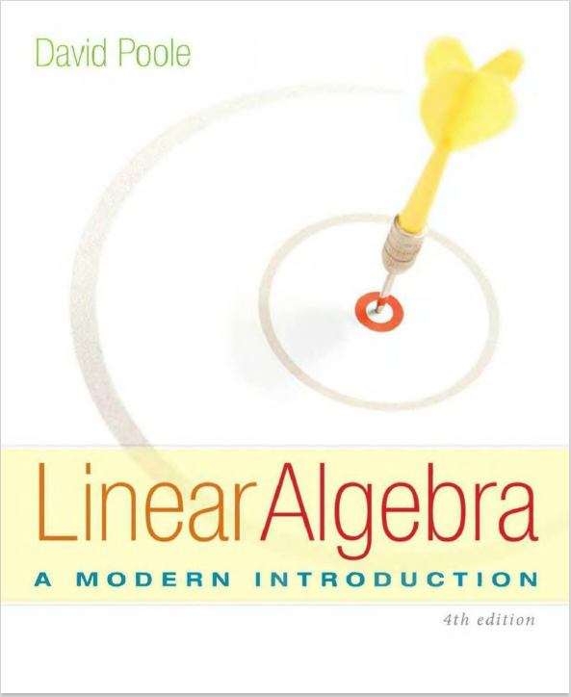
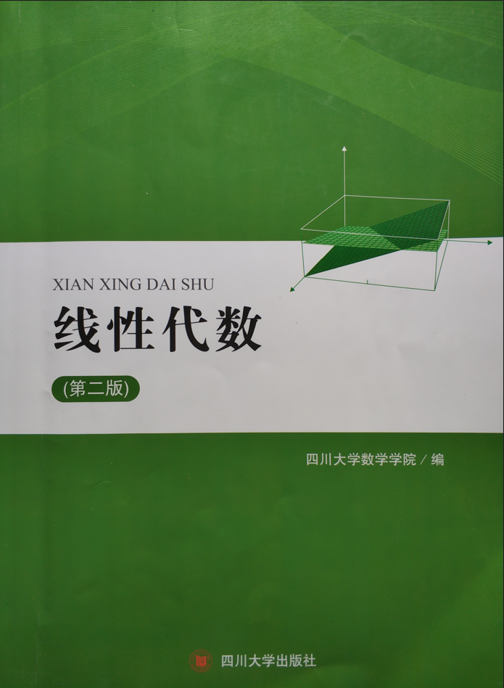
Text book and reference
David Poole: Linear Algebra, A Modern Introduction, 4th ed

Slide 6
Grades
Continuous assessment: 40%
Homework
Quizzes (random)
Checking attendance (random)
Final Examination: 60%

Slide 7
Introduction
Comments
Why we need to learn this course?
What we need to learn?

Slide 8
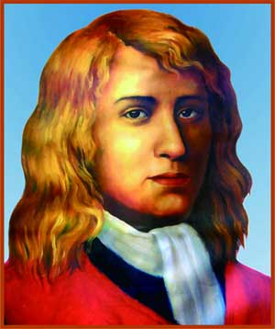
First Science Leap
Isaac Newton (1643-1727)
The establishment of calculus
The Real World → Mathematical Models → Qualitative Analysis → Objective World
Foundation 1: calculus, mathematical physics equation
Bottleneck: Quantitative?

Slide 9
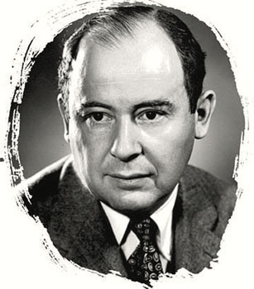
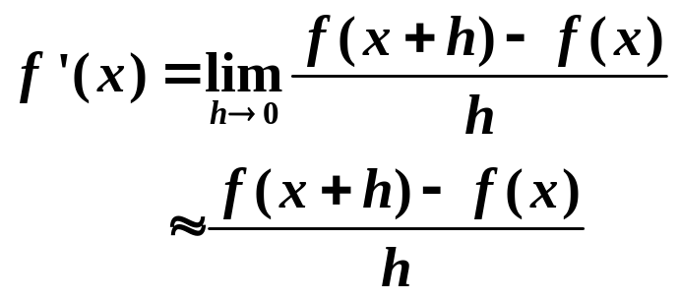
Second Science Leap
John von Neumann (1903-1957)
Father of computer
Scientific Computing: Mathematical Models → Discrete
→ Numerical results → Objective world
Foundation 2: computer techniques (coding), linear algebra, numerical methods

Slide 10

The Third Scientific Leap?
An Internet Minute (2021):
Wechat texts:21.1 million
Sending 197.6 million emails
Data → Information
Foundation 3: Matrix Computing, Statistics, Data Science

Slide 11
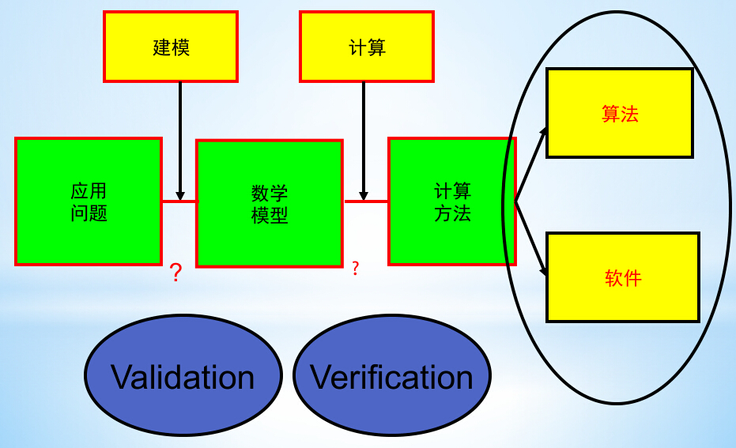
Modern Science

Slide 12

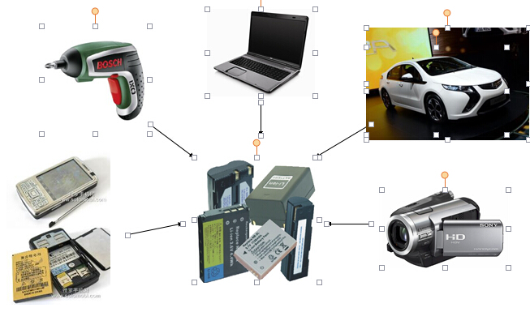
Application: Lithium-ion Battery

Slide 13
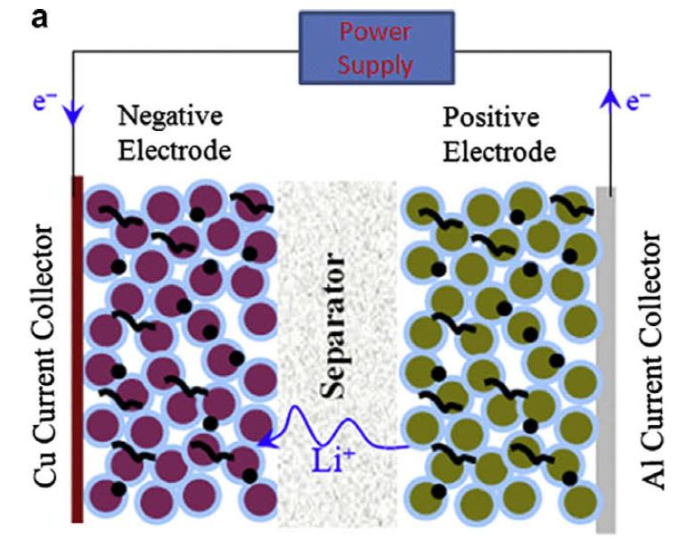
Battery Structure

Slide 14
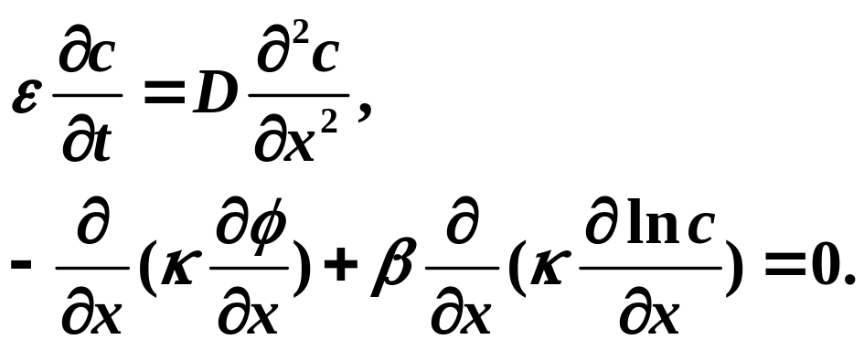
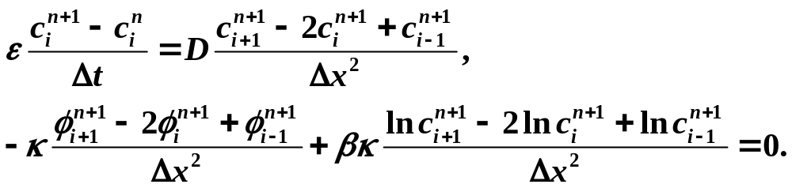
Mathematical Model and Solution
Model:
Discrete:
Mass conservation
Ohm’s law

Slide 15
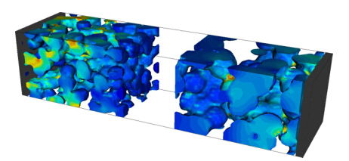
Simulation Results

Slide 16
Introduction
Comments
Why we need to learn this course?
What we need to learn?

Slide 17
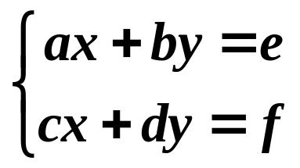
Modern science
Mathematical model linear systems
Solution of linear systems?
Example: ax=b
(a) x − y = 1
x + y = 3
(b) x − y = 2
2x − 2y = 4
(c) x − y = 1
x − y = 3

Slide 18
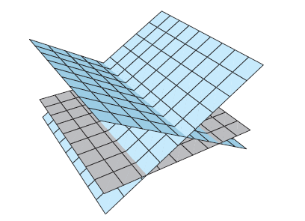
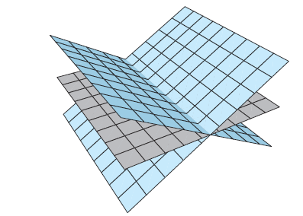
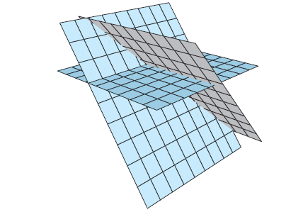
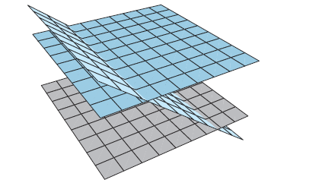
a.
b.
c.
d.

Slide 19
contents
Linear systems
Matrices
Determinant
Linear spaces
Eigen value and eigen vectors

Slide 20
Systems of Linear Equations

Slide 21
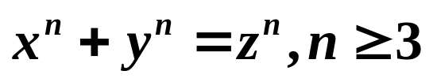
Introduction to Systems of Linear Equations
Equality v.s. Equation
Definition
A linear equation in the n variables x₁, x₂, ..., x _{n} is an equation that can be written in the form
a₁x₁ + a₂x₂ + ... + a_{n}x_{n} = b
where the coefficients a₁, a₂, ..., a_{n} and the constant term b are constants.
A solution of a linear equation a₁x₁ + a₂x₂ + ... + a_{n}x_{n} = b is a vector [s₁, s₂, ..., s _{n}] whose components satisfy the equation when we substitute x₁ = s₁, x₂ = s₂, ... , x_{n} = s_{n}.

Slide 22
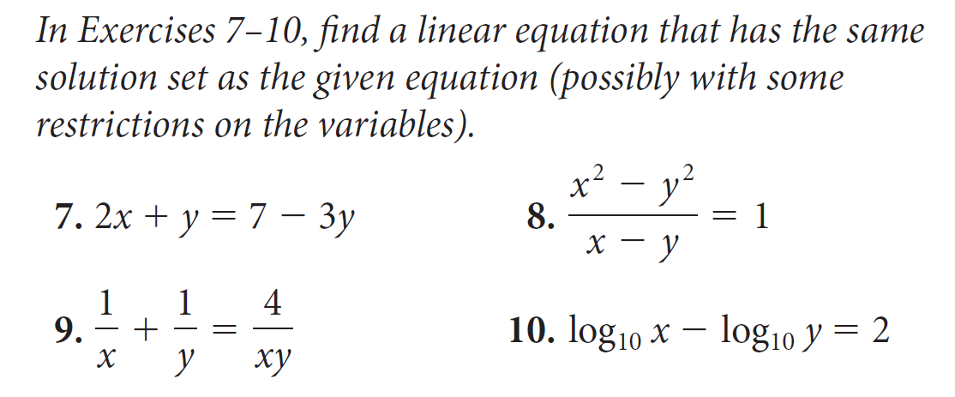

Slide 23
Linear Systems
A system of linear equations is a finite set of linear equations, each with the same variables.
General formulation of linear systems
classification
homogeneous
inhomogeneous
indefinite (diophantine)
well defined
overdetermined

Slide 24
Solution set
A solution of a system of linear equations is a vector that is simultaneously a solution of each equation in the system.
The solution set of a system of linear equations is the set of all solutions of the system.
We will refer to the process of finding the solution set of a system of linear equations as “solving the system.”

Slide 25
Cases of solution set
A system of linear equations is called consistent if it has at least one solution. A system with no solutions is called inconsistent.
A system of linear equations with real coefficients has either
(a) a unique solution (a consistent system) or
(b) infinitely many solutions (a consistent system) or
(c) no solutions (an inconsistent system).

Slide 26
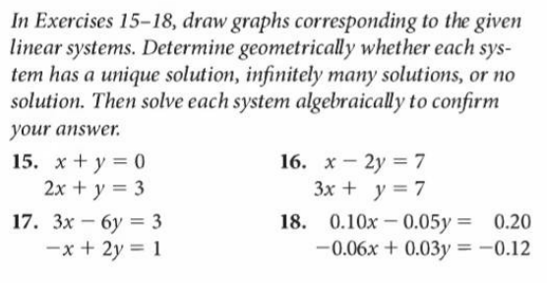
Homework 1

